Slide 1


Genie in a bot
The real genies behind:
Chen Chang
Charu Agrawal
Jason Hilliard
Kartik Dave
Worldpay
HACKATHON

Slide 2


Project Overview
Merchants
Product Manager
Senior Leaders
SRO
… & many more
Genie Skill
Intent
Sandbox Status
Daily
Merchant
Transaction
Analysis
Specific Time Merchant Transaction Analysis
Open Events for SRO team

Slide 3



System Architecture
World Pay Sandbox
Alexa Lambda Function
AWS Kafka
Worldpay
Payment
Skill/Intents
eComm
Vantiv Core
WP Heritage
WP Web Service

Slide 4

Imagine! It would have been so easy if I just need to ask about sandbox status and genie appears and tells me about it. That will make life so easy.
But it’s just what you can imagine of ☹
In the past, merchants needed to navigate to Worldpay Github IO to check status

Slide 5
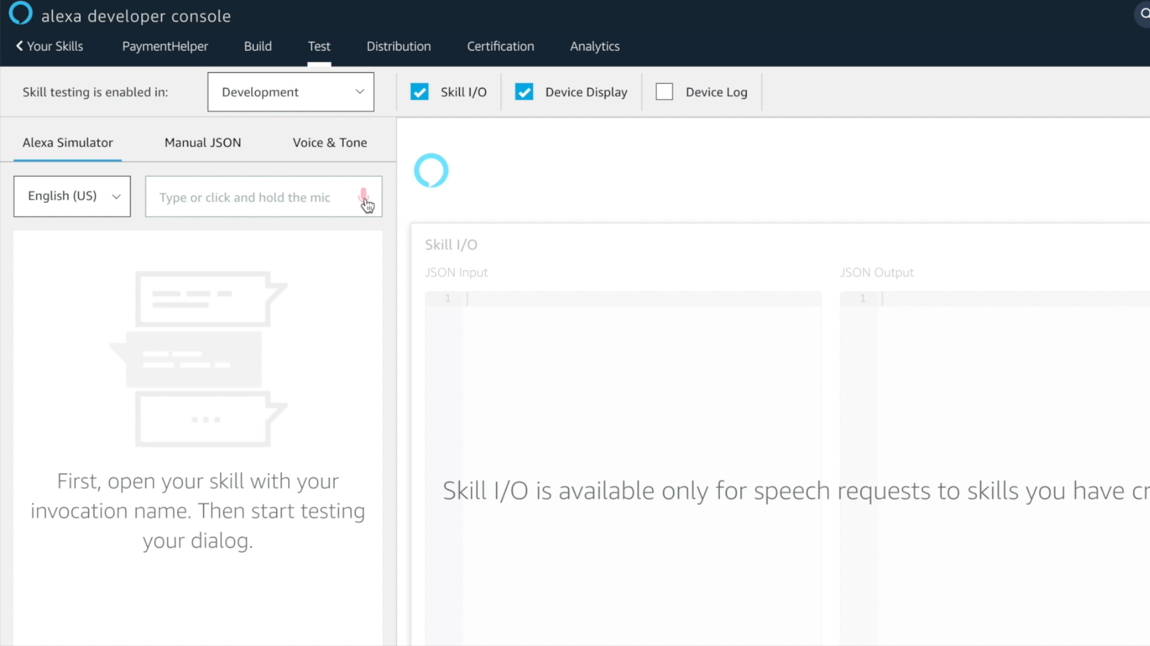

Slide 6

Transaction Analysis (Merchants)
Genie, give me today’s transaction summary. I have a good feeling!
Get total transactions, and the number of approved transactions for the current day
Get a combined total transactions and approved transactions for a number of previous days

Slide 7
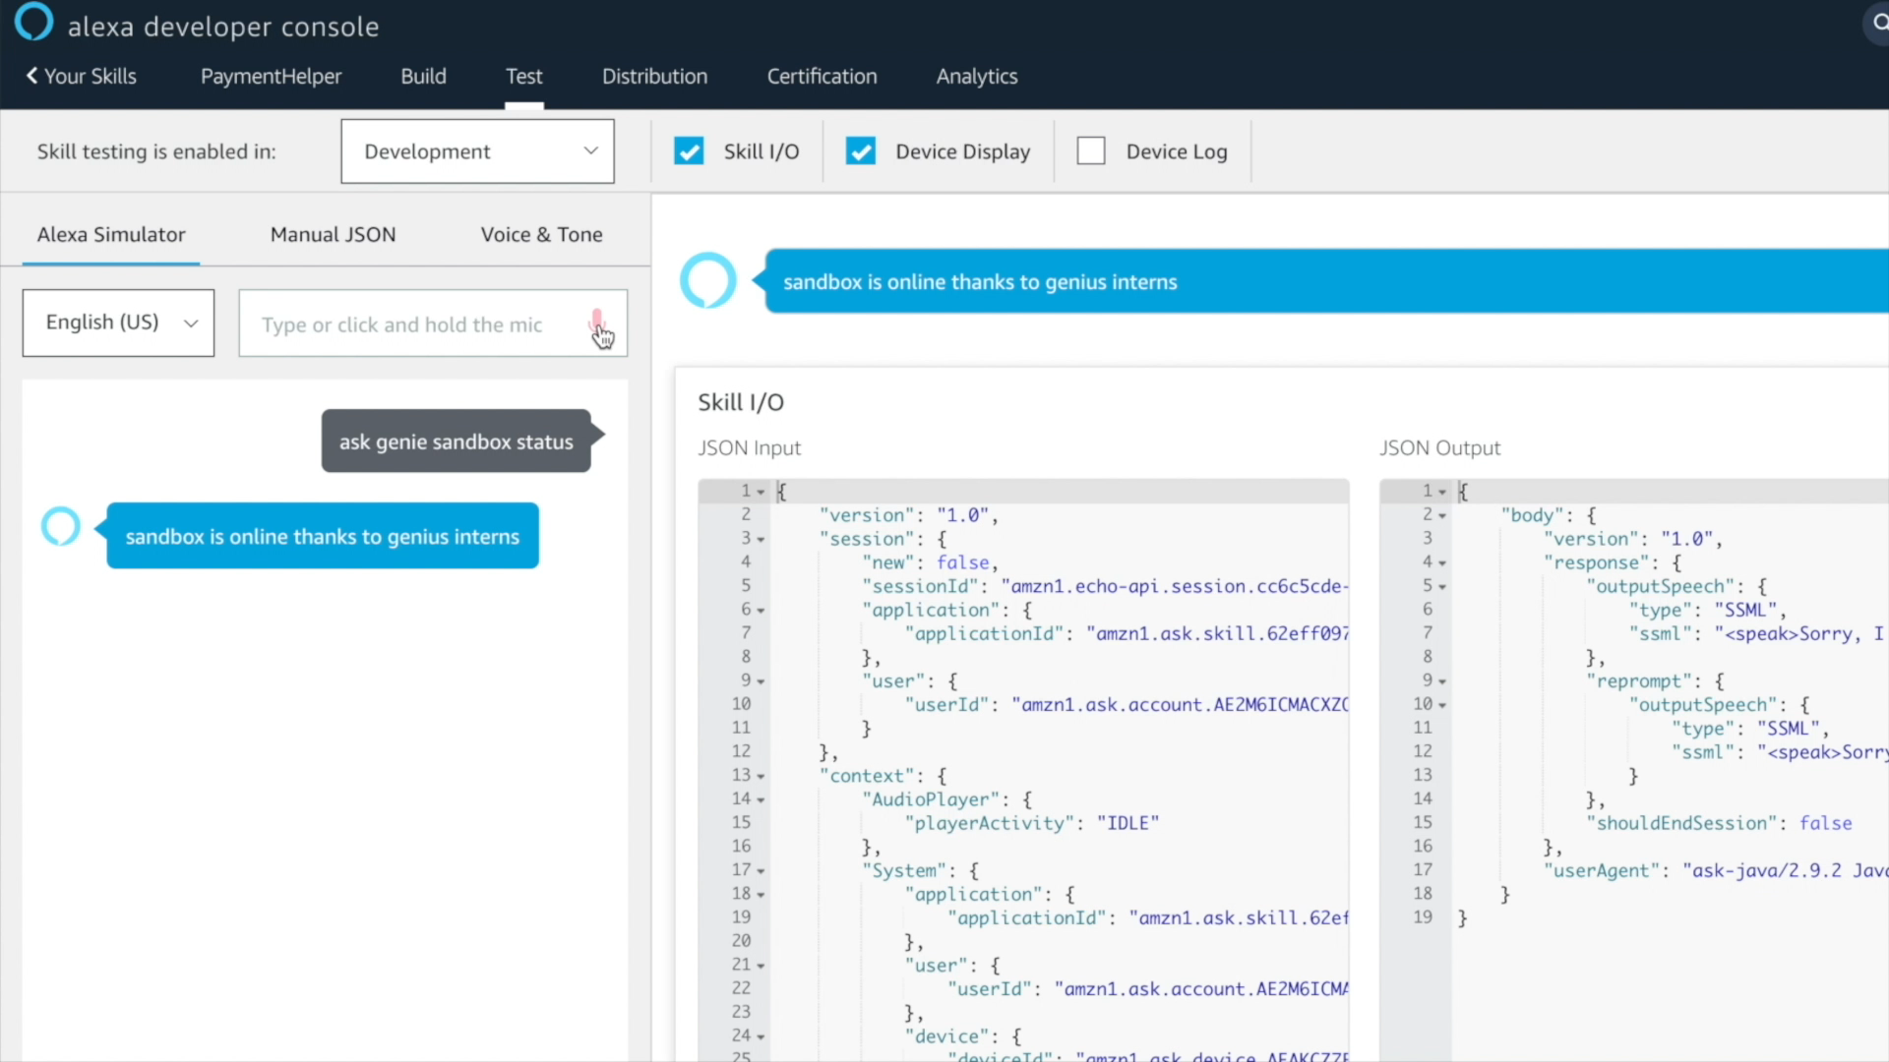

Slide 8
The Fun Challenges
Account Linking Implementation and test
Connecting with RDS
Proxy Issues to connect to inhouse resources and services
Email Authentication (Half Way there)

Slide 9
Future Scope
More intents can be added for larger set of end users
Replacing AWS Lambda with VAP (Inhouse services)
Adding more authentication for the merchants
Optimize the overall response time
Account Linking for better customer experience

Slide 10


